Slide 1

Vaultic Protocol: Decentralized NFT-Collateral Lending on ICP
Introducing a breakthrough decentralized lending platform leveraging NFTs as collateral on the Internet Computer Protocol.

Slide 2

The Problem with Current NFT Lending
Lack of Standardization
High Risk Exposure
Poor metadata filtering increases lending risk
NFT lending lacks uniform standards across platforms
Centralized Controls
Loan terms and approvals dominated by intermediaries

Slide 3
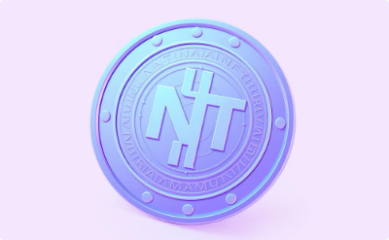

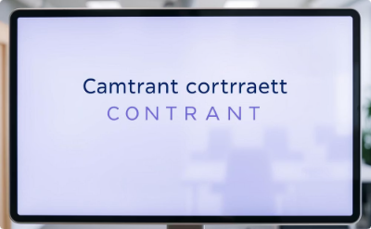

Our Solution: Vaultic Protocol
Secure NFTs as loan collateral with DIP721 and EXT standards
Metadata-driven risk assessment for smarter lending decisions
Transparent offer acceptance and rejection process
Fully decentralized lending on the Internet Computer Protocol

Slide 4

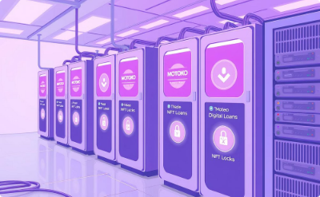
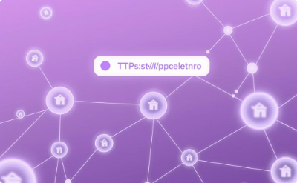

Vaultic System Architecture
Frontend
Backend
Metadata Fetching
Risk Logic
React interface with Tailwind styling and Internet Identity authentication
Motoko canisters handling NFT locks and loan management
Secure HTTPS outcalls to gather NFT marketplace metadata
Intelligent evaluation of NFT traits to assess loan risks

Slide 5

Development Progress
Modular core logic implemented
Metadata extraction via HTTPS outcalls
Attribute-based risk mapping framework
Borrowing & lending UI wireframes done

Slide 6
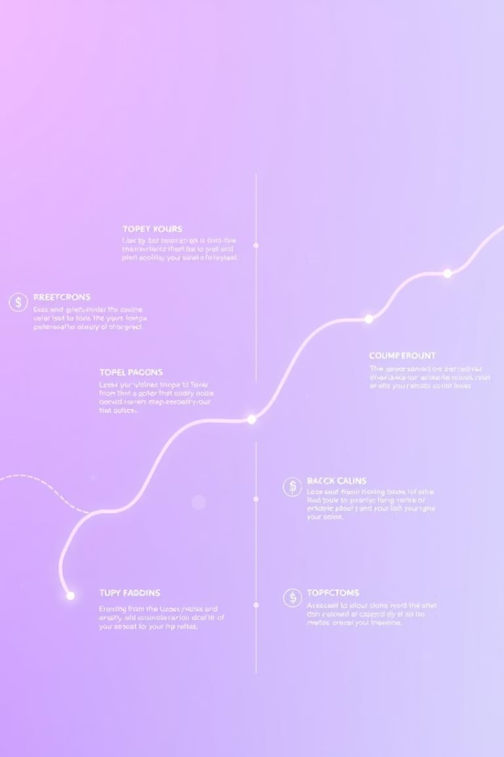
Next Steps in Vaultic Roadmap
1
NFT Locking
Enable DIP721 and EXT locking in canisters
2
Attribute Scoring
Normalize and score NFT traits for risk
3
Smart Contract Logic
Define automated loan conditions
4
Frontend Build
Responsive UX for loan offers and acceptance

Slide 7




Join Us: Collaborate & Contribute
GitHub
LinkedIn
Twitter
Open source code repository
Connect professionally
Stay updated & engage
DM us, fork the repo, help shape Vaultic’s future.

Slide 8

Why Choose ICP for Vaultic?
Scalability
Canisters allow high throughput smart contracts
Decentralization
Trustless environment with no intermediaries
Security
Robust cryptographic guarantees
Seamless NFT Integration
DIP721 and extended standards support

Slide 9

Key Takeaways & Next Steps
Build & Test
Complete NFT Locking & Scoring Systems
Launch & Engage
Deploy platform, onboard users and lenders
Iterate & Govern
Community-led improvements for fairness
Join us to unlock NFT lending’s full potential on ICP.

